Slide 1
MEDICAL APPOINTMENT NO-SHOW
Group Members
Mariam Azam
Fatima Meftah
Ammar Khamis

Slide 2
Problem Statement & Aims
Missed medical appointments can disrupt healthcare delivery and negatively impact patient treatment. This project aims to provide insights to the healthcare providers to develop targeted strategies to reduce no-show rates and improve service efficiency.
To explore the influence of patient demographics and other factors on appointment attendance status.
01
To recommend efficient strategies to healthcare providers to reduce no-show rates.
02

Slide 3
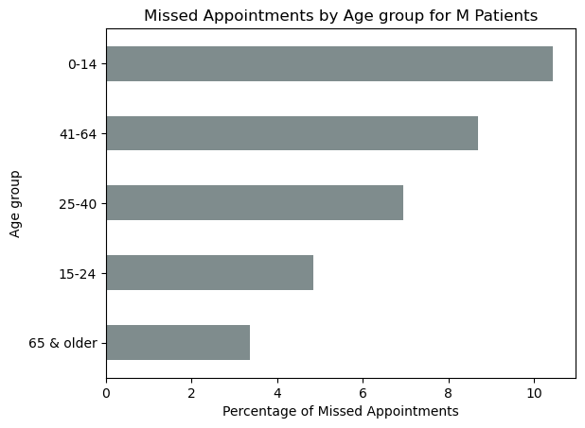
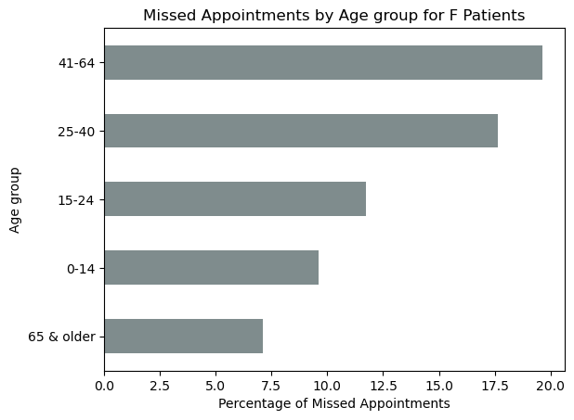
Patient Demographics & Appointment Status
Women account for majority of missed appointments across all age groups, with most of them falling in the category of age 41-64 and 25-40 (25-64).
Men account for only 10% missed appointments which is considerably lower compared to women.

Slide 4
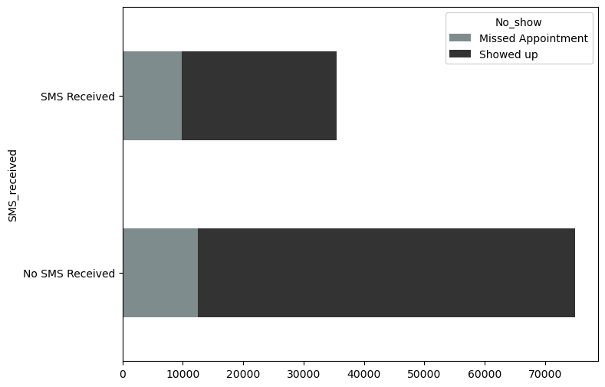
SMS Reminders & Appointment Status
The most frequent occurrence in the data is patients showing up for appointments without receiving an SMS reminder.
While SMS reminders did correlate with some patients showing up, a significant number of those who received reminders still missed their appointments.
This suggests that SMS reminders alone do not guarantee higher attendance in this dataset.

Slide 5
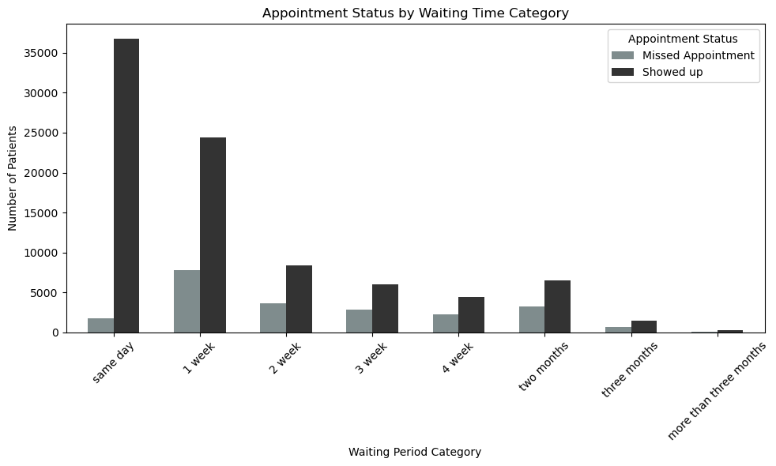
Waiting Days
Most patients showed up when the waiting time was short, especially within the same week

Slide 6
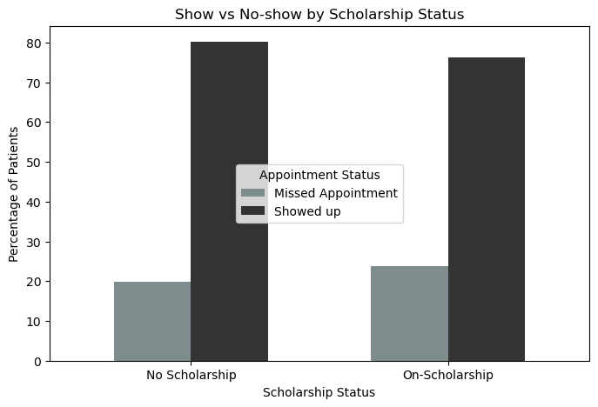
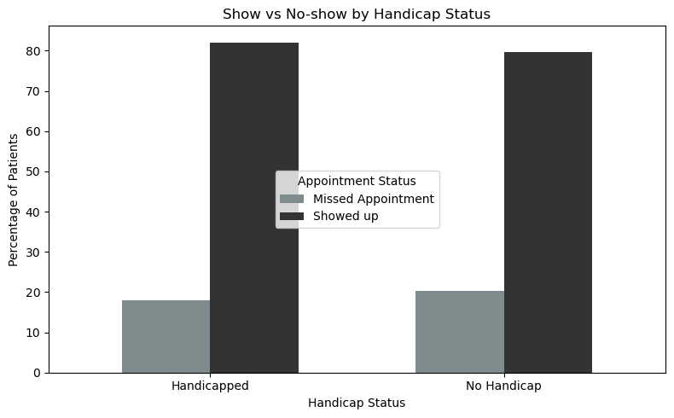
Scholarship
Handicap
Patients on scholarships had a slightly higher no-show rate (23.7%) than those without scholarships (19.8%) indicating a minor difference.
Patients with disabilities had a slightly lower no-show rate (17.9%) than non-disabled patients (20.2%).This difference is small and doesn’t suggest a strong influence on attendance.

Slide 7
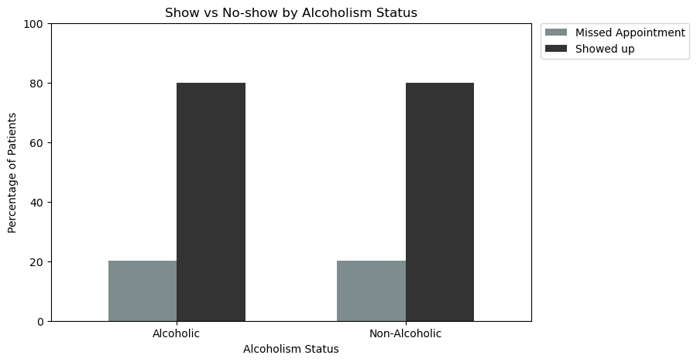
Alcoholism
The no-show rates for alcoholic and non-alcoholic patients are nearly identical (about 20%).
This indicates that alcoholism does not significantly impact appointment attendance.

Slide 8
Recommendations
Healthcare providers could investigate the underlying causes of patients missing appointments, especially women since they have the higher no-show rates.
Additional factors resulting in higher no-show rates could be explored such as social and economic aspects:
Caregiving Responsibilities
Lack of Health Literacy
Language Barriers
Transportation Issues
Job Constraints
Cost of Healthcare

